Slide 1
Module 5: Deployment

Slide 3
Agenda
How to deploy a package using SSDT?
How to use ISPAC to deploy an package?
How to setup Environments in SSIS CatalogDB?

Slide 4
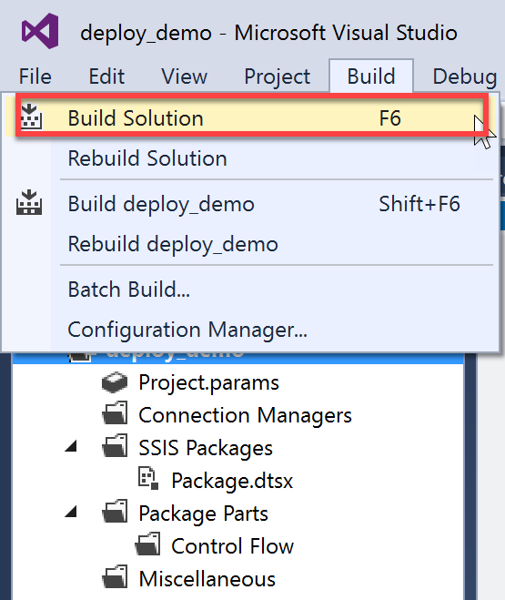
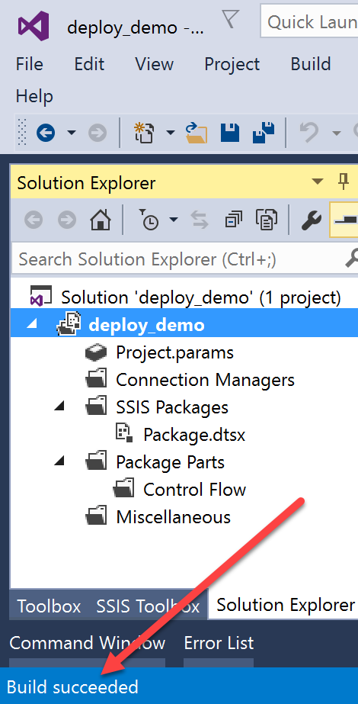
Building Project
Bundles all packages, project parameter, shared connections to an .ispac file in \bin\Development\ subfolder
Two options to build
Build Solution – builds all projects within a solution (F6)
i.e. a solution can have multiple SSIS projects
Build <Project_Name> - build only the currently single project
(Shift+F6)

Slide 5
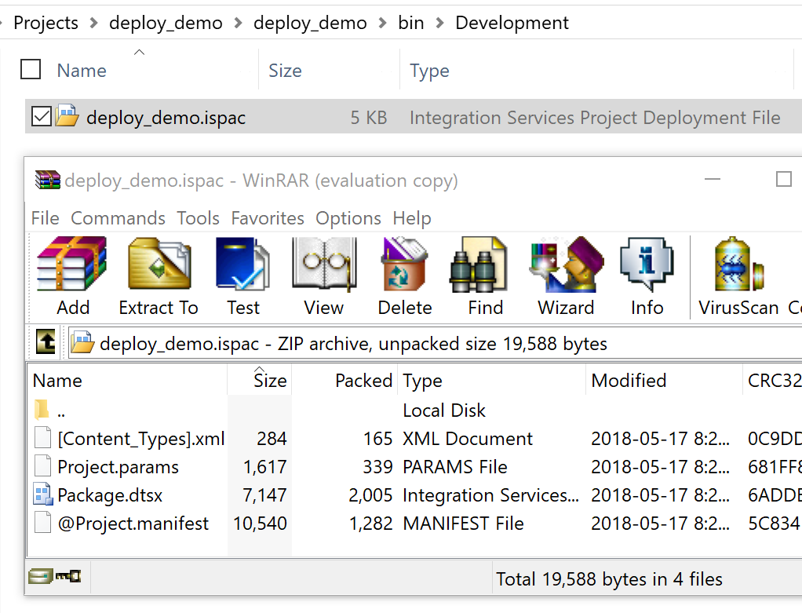
.Ispac file
Output of a solution or project Build process
It is a zip file containing all packages, project parameter, shared connections
You can recreate Visual Studio Solution if you have .ispac file using “Integration Services Import Project Wizard” from SSDT
Select Project Deployment File (i.e. .ispac file)
Or
Select Project from SSISDB Catalog

Slide 6
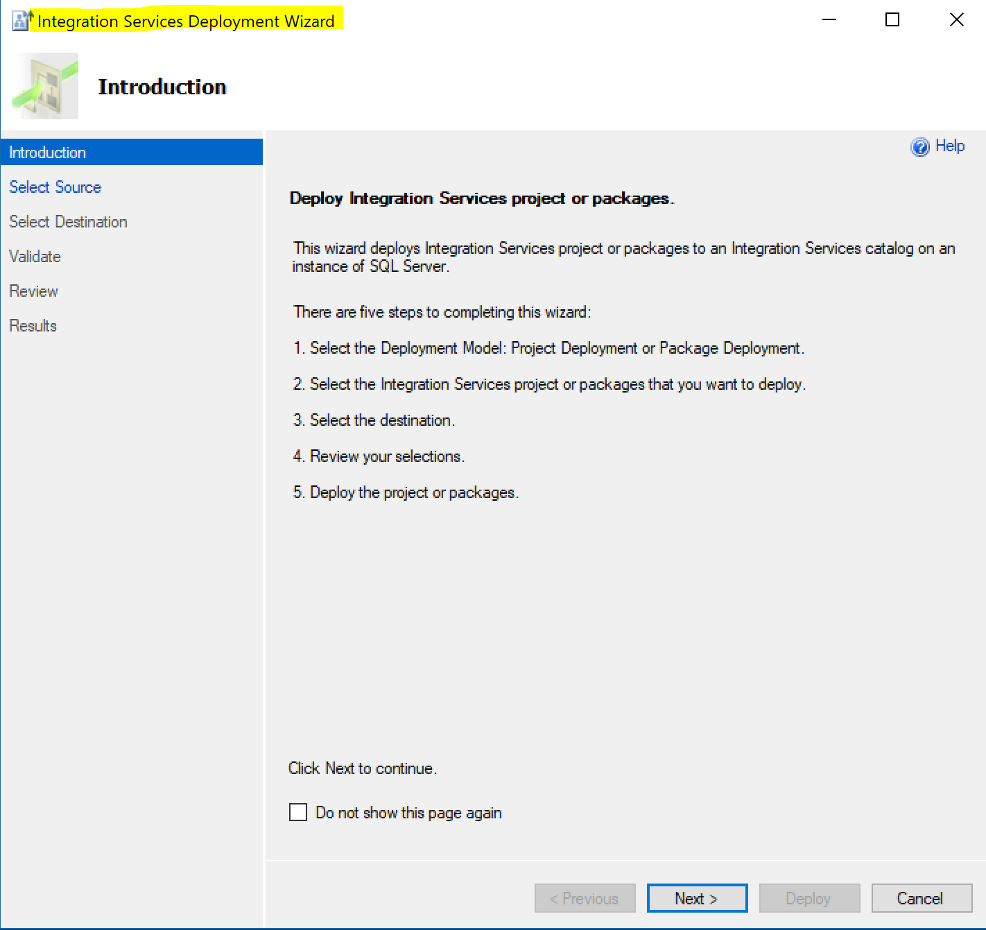
Deploying .ispac
Deployed with Integration Services Deployment Wizard
Three ways to call it
By itself as a wizard, from Windows Start bar
Need to specify .ispac file and deploy location
Within SSDT
Right-click project in Solution Explorer and select Deploy
Filename is automatically passed as argument to wizard
Need to specify deploy location on first deploy
Deploy Location saved for subsequent deploys in
Project Properties\Configuration Properties\Deployment
Double-clicking on .ispac file in windows explorer
Filename is automatically passed as argument to wizard
Need to specify Deploy location
DBAs do not require SSDT to deploy

Slide 7
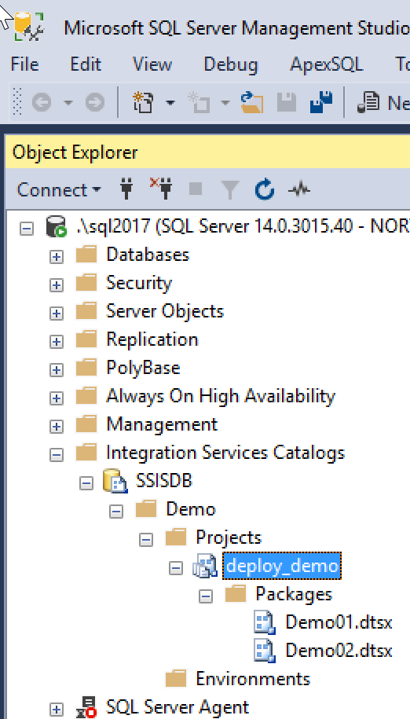
Deployment Location
SSISDB Catalog is the preferred deployment location
Use SSMS to browse, execute deployed packages

Slide 8
How to deploy using SSDT?
Demo
Notes:
Deploy using SSDT
Show Project Properties\Configuration Properties\Deployment is empty. Close properties dialog.
deploy to SSISDB catalog
Show Project Properties\Configuration Properties\Deployment is not empty. Close properties dialog.
redeploy to SSISDB catalog, notice deploy location is prepopulated now.

Slide 9
How to deploy using ISPAC file?
Demo
Notes:
Double-click to deploy

Slide 10
Environment
Allows you to save a set of preconfigured values as an environment e.g.: Dev, QA, Prod
Allows you to run the same package against different environments without creating multiple copies of the same project targeted for different servers (dev, qa, prod)

Slide 11
Environment Setup
Create Environment, e.g.: Dev, QA, Prod
Create Variables within each Environment
Preferably same name as project parameter or package parameter names for All environments.
Configure Projects to reference Environment
i.e., which allowable environments can be used to configure the project
Configure Mapping of Environment Variable to Parameter Value
Right-click Project -> Configure -> Parameters -> Set Parameter value to Environment Variable
Validate Environment settings;
Right-click Project -> Validate

Slide 12
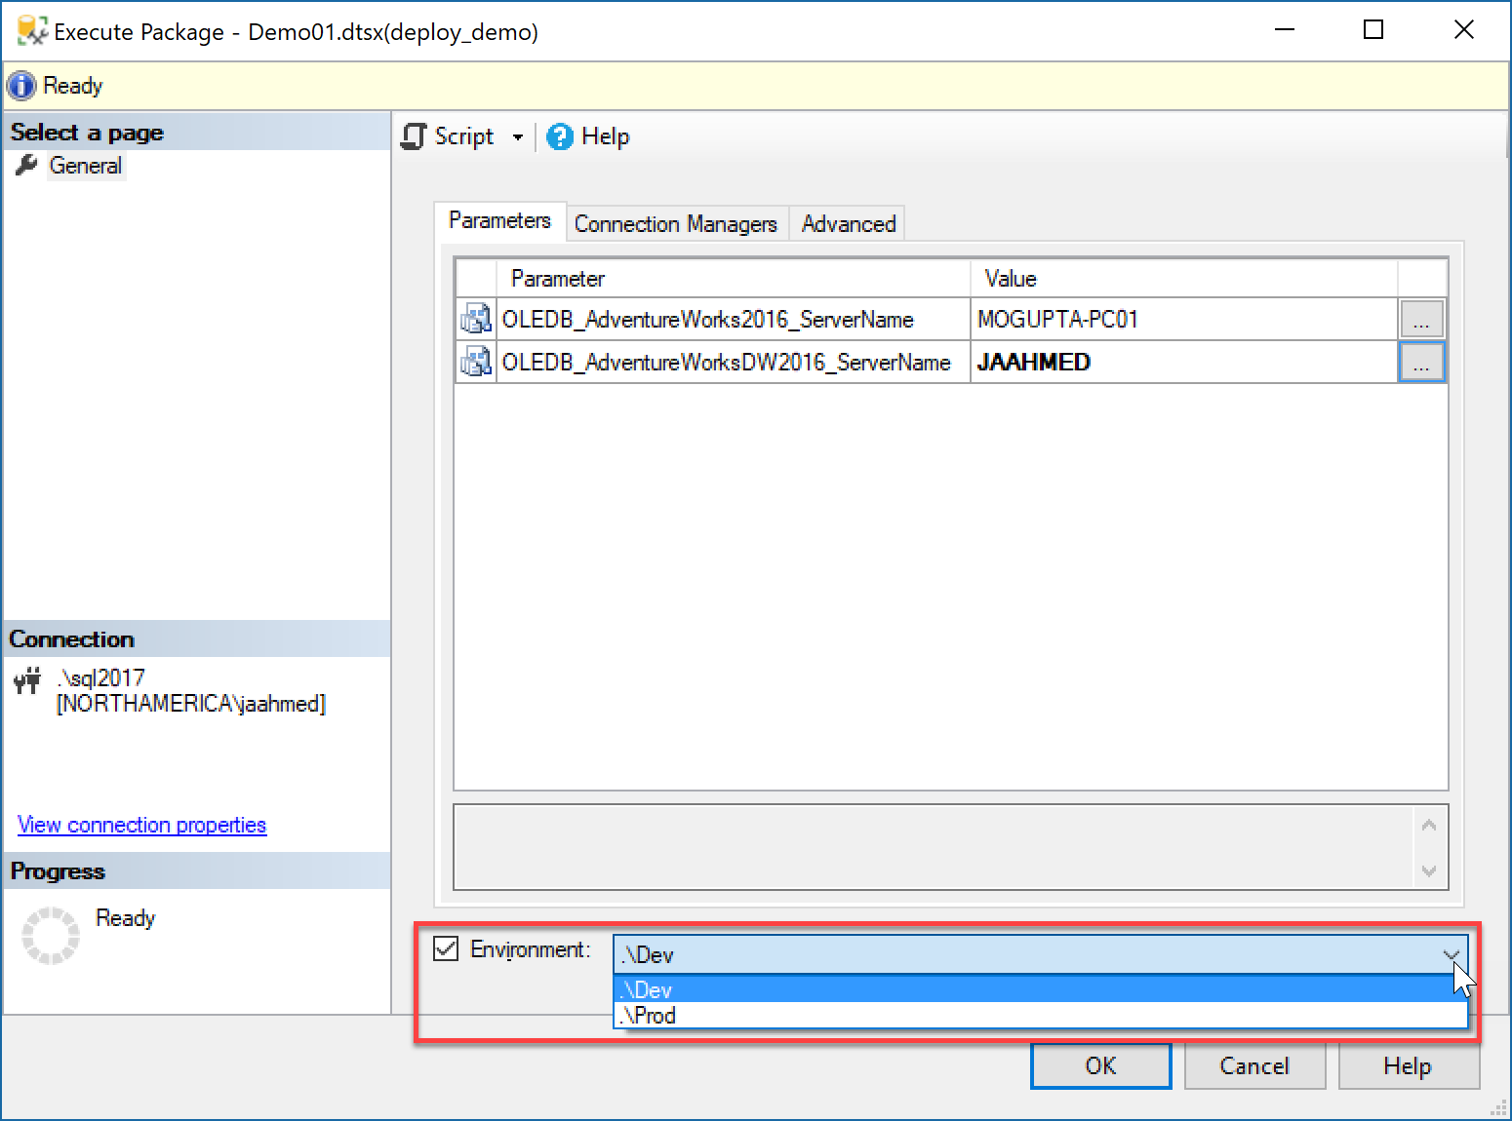
Executing using Environment setting
Create Environment, e.g.: Dev, QA, Prod
Environment Variable values will override default values

Slide 13
Deployment & Scheduling SSIS Jobs
Lab 01

